Slide 1


DETAILED ANALYSIS OF AIR POLLUTANTS
BY
MPD18I003
MPD18I004
MPD18I013
MPD18I028

Slide 2
POLLUTANT 1: OZONE
What is ozone?:Ozone, or trioxygen, is an inorganic molecule with the chemical formula O ₃. It is a pale blue gas with a distinctively pungent smell.
Sources of ozone :In the Earth's lower atmosphere, near ground level, ozone is formed when pollutants emitted by cars, power plants and other sources react chemically in the presence of sunlight. Ozone at ground level is a harmful air pollutant.
Natural Formation:Naturally it is formed through the interactions of solar ultraviolet (UV) radiation with molecular oxygen O2. It reduces the harmful UV radiation reaching the Earth's surface.
Types of ozone
Good Ozone : Occurs naturally in the upper atmosphere of the Earth and is also known as stratospheric ozone. Here, it forms protective shields which protect us from sun's harmful UV radiations. Due to various manmade chemicals it is partially destroyed and causes hole in the ozone.
Bad Ozone : It is ground level ozone which is not directly emitted into the air and is known as Tropospheric ozone. This happens when the pollutants are emitted by cars, power plants, industrial boilers; chemical plants etc. and these chemicals react in the presence of sunlight.
Effects on health and environment
Breathing ozone can cause chest pain, coughing, throat irritation and airway inflammation.
Increases the risk of respiratory infection and susceptibility to pulmonary inflammation (COPD).
Ozone causes harm to vegetation and ecosystems including forests, parks, wildlife refuges etc.
Actions to reduce air pollution due to ozone
Conserve energy - at home, at work, everywhere.
Look for the ENERGY STAR label when buying home or office equipment.
Carpool, use public transportation, bike, or walk whenever possible.
Follow gasoline refueling instructions for efficient vapor recovery, being careful not to spill fuel and always tightening your gas cap securely.
Consider purchasing portable gasoline containers labelled “spill-proof,” where available.
Keep car, boat, and other engines properly tuned.
Be sure your tires are properly inflated.
Use environmentally safe paints and cleaning products whenever possible.
Mulch or compost leaves and yard waste.
Consider using gas logs instead of wood.

Slide 3
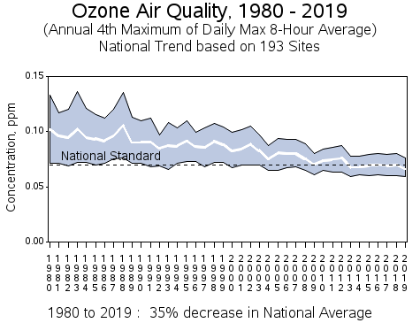
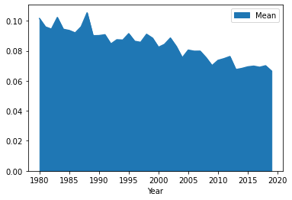
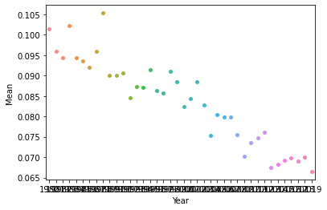
PREVIOUS TREND
Ozone (1980-2019)pmm(PYTHON)
Ozone Swarm plot(ppm)
Source from
https://www.epa.gov/air-trends/ozone-trends

Slide 4
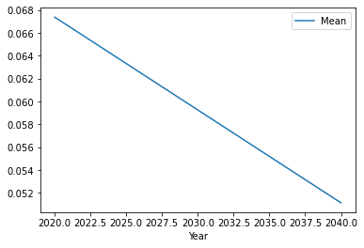
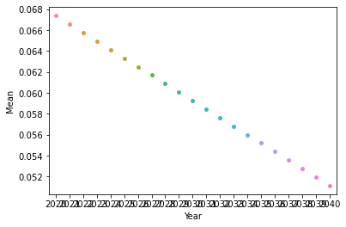
FUTURE TREND
OZONE(ppm) from 2020-2040
OZONE(ppm) Swarm Plot
Error in the model
MAE: 0.00233614411110793
MSE: 7.474213118491529e-06
RMSE: 0.002733900714819675

Slide 5
POLLUTANT 2: LEAD
What is lead?
Lead (Pb) is an elemental heavy metal found naturally in the environment as well as in manufactured products. Lead can be released directly into the air, as suspended particles.
Historic major sources of lead air emissions were motor vehicles and industrial sources. Motor-vehicle emissions have been reduced by the phasing out of leaded gasoline, but lead is still used in general-aviation gasoline for piston-engine aircraft. Lead that is emitted into the air can be inhaled or can be ingested, primarily through contact with contaminated soils or other surfaces.
Primary stationary sources of lead today include:
lead smelters
waste incinerators
utilities
lead-acid battery manufacturers and recyclers
Other industrial sources of lead emissions can include:
metals processing
iron and steel foundries
copper smelters
industrial, commercial, and institutional boilers
What is the effect on Humans?
Humans may be exposed to lead from air pollution directly, through inhalation, or through the incidental ingestion of lead that has settled out from the air onto soil or dust. Ingestion of lead settled onto surfaces is the main route of human exposure to lead originally released into the air.
Once taken into the body, lead distributes throughout the body in the blood and accumulates in the bones. Lead exposure affects the oxygen-carrying capacity of the blood.
Infants and young children are especially sensitive to even low levels of lead, which may contribute to behavioral problems, learning deficits, and lowered IQ.
What are the effects of lead on ecosystems?
Lead is persistent in the environment and can be added to soils and sediments through deposition from sources of lead air pollution. Elevated lead in the environment can result in decreased growth and reproductive rates in plants and animals, and neurological effects in vertebrates.
Ecosystems near point sources of lead demonstrate a wide range of adverse effects, including losses in biodiversity, changes in community composition, decreased growth and reproductive rates in plants and animals, and neurological effects in vertebrates.

Slide 6
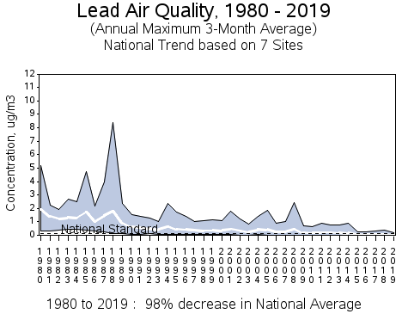
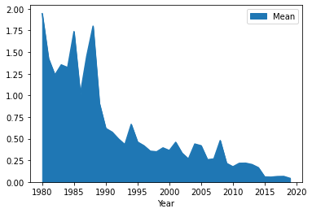
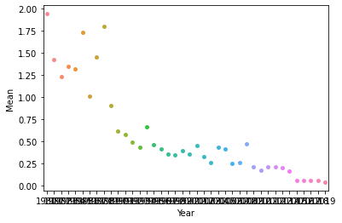
PREVIOUS TRENDS
Lead(1980-2019)ug/m^3(PYTHON)
Lead Swarm Plot(ug/m^3)
Source from
https://www.epa.gov/air-trends/lead-trends

Slide 7
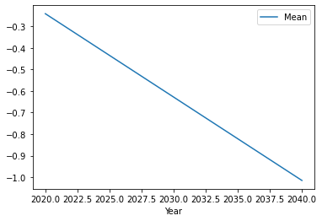
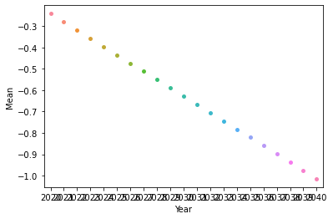
FUTURE TRENDS
Lead(2020-2040)ug/m^3
Lead Swarm Plot(ug/m^3)
Error in the model
MAE: 0.2139040337838184
MSE: 0.07192478645784676
RMSE: 0.26818796851806526

Slide 8
PROPERTIES AND ITS NATURE AS A POLLUTANT(NO2)
Nitrogen dioxide is a nasty-smelling gas which is formed naturally in the atmosphere by lightning and produced by plants, soil and water. However, only about 1% of the total amount of nitrogen dioxide found in our cities' air is formed this way.
Nitrogen dioxide is an important air pollutant because it contributes to the formation of photochemical smog, which can affect human health adversely.
Sources of nitrogen dioxide are petrol and metal refining, electricity generation from coal-fired power stations, other manufacturing industries and food processing.
The main effect of breathing in raised levels of nitrogen dioxide is the increased likelihood of respiratory problems such as wheezing, coughing, colds, flu and bronchitis.
To reduce emission of NO2:
implementing national fuel quality standards;
supporting the implementation of tighter vehicle emission standards;
developing and promoting alternative fuels;

Slide 9
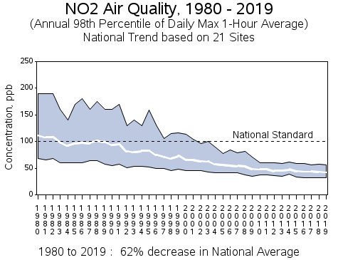
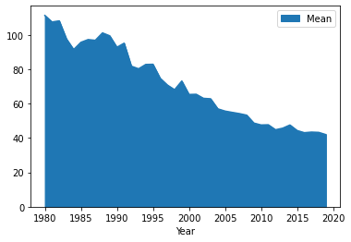
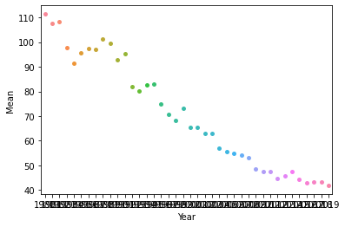
PREVIOUS TRENDS
NO2(1980-2019)pmm(PYTHON)
NO2 Swarm plot(ppm)
Source from
https://www.epa.gov/air-trends/nitrogen-dioxide-trends

Slide 10
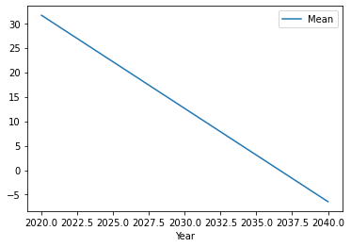
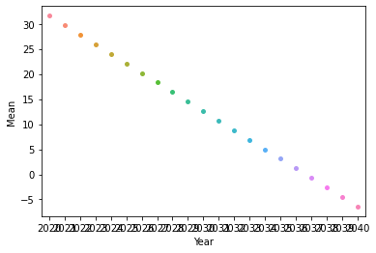
FUTURE TRENDS
NO2(ppm) from 2020-2040
NO2(ppm) Swarm Plot
Error in the model
MAE: 3.2098110406256866
MSE: 14.601673868540495 RMSE: 3.821213664340231

Slide 11
POLLUTANT 4: SO2(Sulphur Dioxide)
What is SO2 ?
SO₂ is a bent molecule with C_{2v} symmetry point group. A valence bond theory approach considering just s and p orbitals would describe the bonding in terms of resonance between two resonance structures, is a colorless, toxic gas with a sharp odor.
Mainly it is produced by the combustion of coal, fuel oil, and gasoline (since these fuels contain sulfur), and in the oxidation of naturally occurring sulfur gases, as in volcanic eruptions.
1. SO2 is a precursor to sulfuric acid, a major constituent of acid rain
2. Explosive volcanoes send SO2 into the stratosphere, where it can form sulfate aerosols.
3. Instruments like the Ozone Monitoring Instrument (OMI) on NASA’s Aura satellite, can track SO2 in the atmosphere.
4. This allows scientists to compare SO2 emissions around the world from both natural sources and man-made emissions(these measurements are recorded in Dobson units—a unit of measurement of atmospheric columnar density).
The Effects on Humans and the Environment
SO2(Sulphur dioxide )is a very water soluble, acidic gas. SO2 irritates the eyes, nose, and lungs. High concentrations of SO2 can result in temporary breathing impairment.

Slide 12
As we discussed earlier, sulfates aerosols that are caused due to explosive volcanoes that persist for long periods of time and can contribute to climate change. Also can be a threat to flying aircrafts flying in that area as these are able to corrode the windows of the aircrafts.
The highest concentrations of sulfur dioxide in the air are found around petrol refineries, chemical manufacturing industries, mineral ore processing plants and power stations. These are main reason for acid rains. Acid rains are very bad for the environment as they one of the main reasons for the PH change of the soil. These can even turn nutrients filled soil into famine lands.
INFERENCE
Lately the SO2 pollution is decreasing mainly due to these factors
Due to implementation of strict national fuel quality standards. Due to this government started promoting alternative fuels like Electric vehicles like Tesla ,vehicles that run on Hydrogen.
In India the main implementations are Bharat Stage emissions protocol(from BS 1-BS 4).Many places have to make electricity production hydropower thus reducing burning of coals.

Slide 13
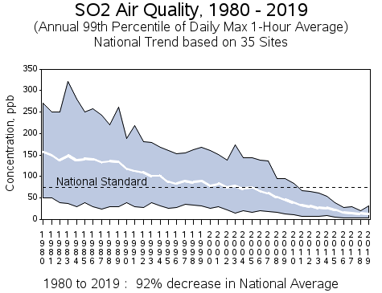
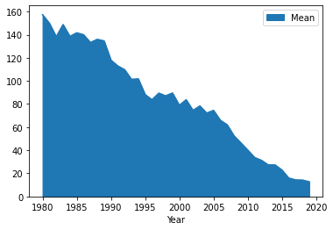
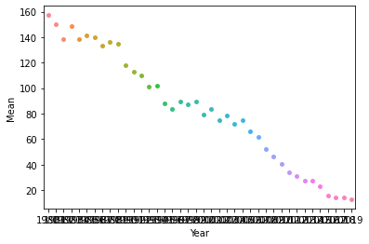
PREVIOUS TRENDS
SO2 (1980-2019)pmm(PYTHON)
SO2 Swarm plot(ppm)
Source from
https://www.epa.gov/air-trends/sulfur-dioxide-trends

Slide 14
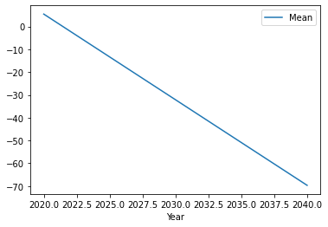
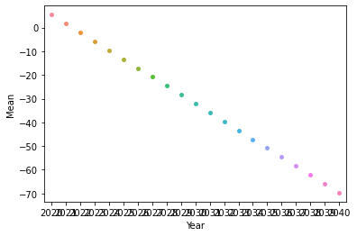
FUTURE TRENDS
SO2(ppm) from 2020-2040
SO2(ppm) Swarm Plot
Error in the model
MAE: 3.2098110406256866
MSE: 14.601673868540495
RMSE: 3.821213664340231

Slide 15
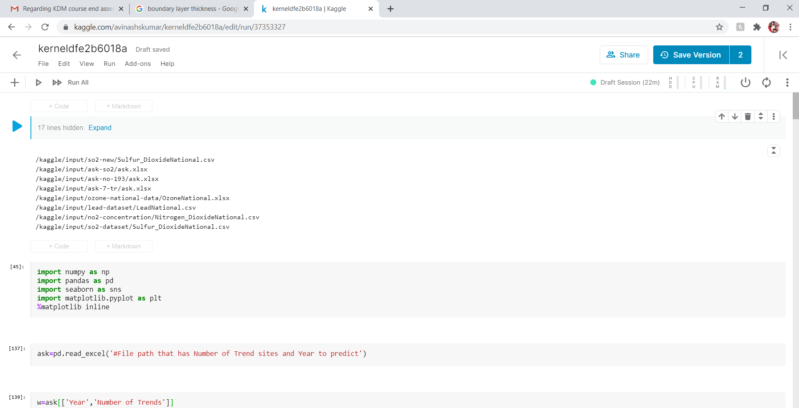
Model used to predict the future levels of pollution

Slide 16
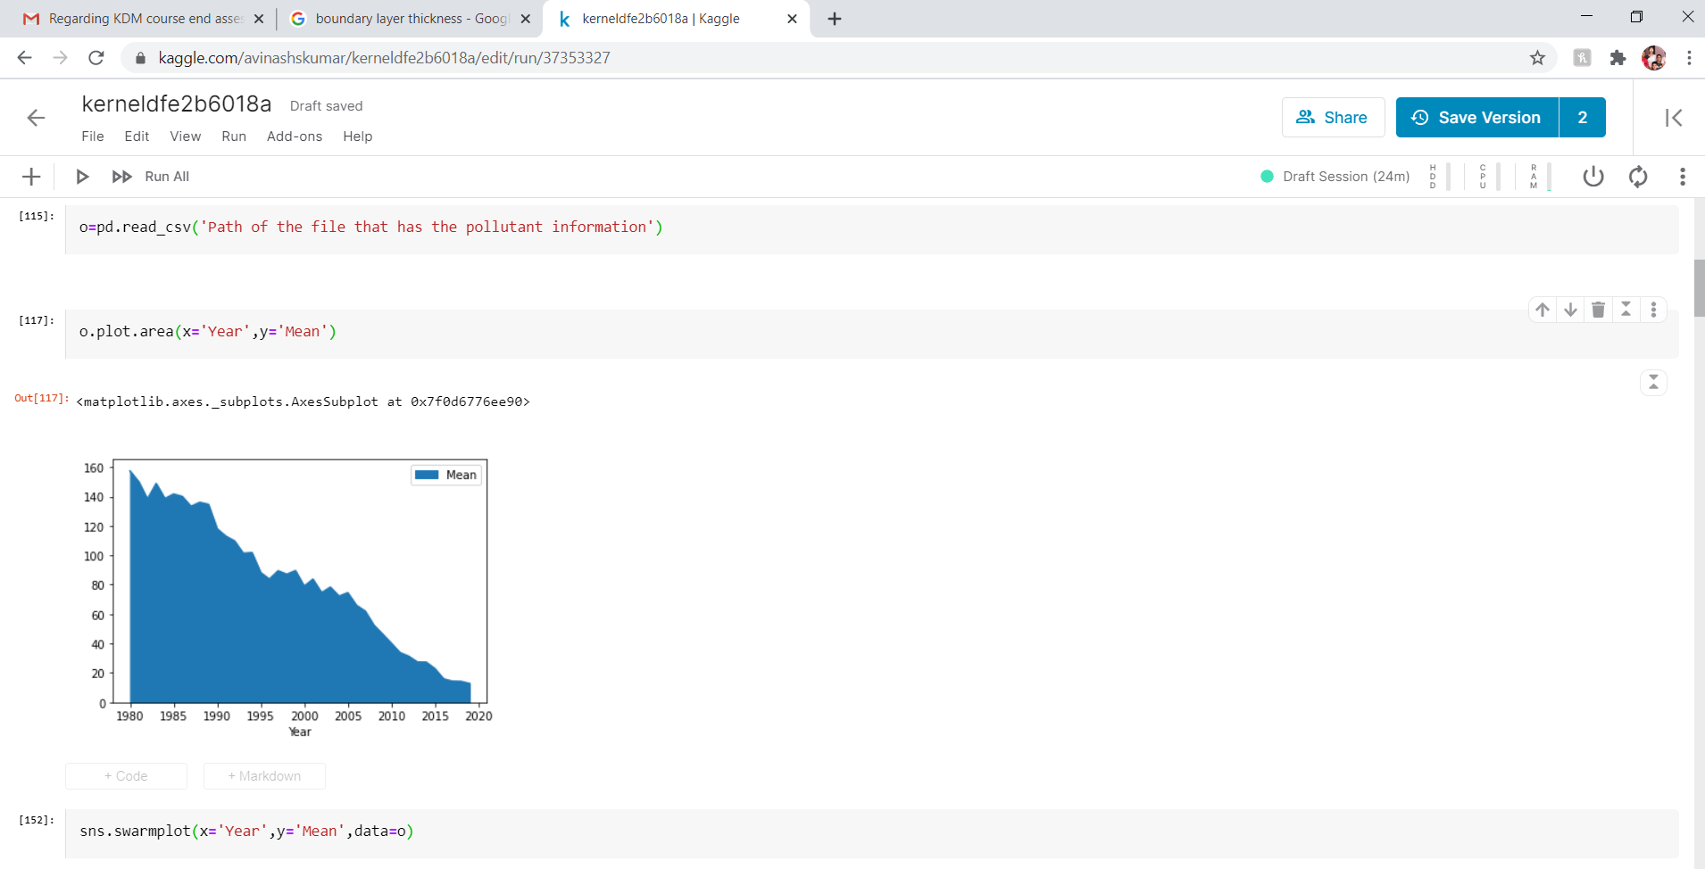
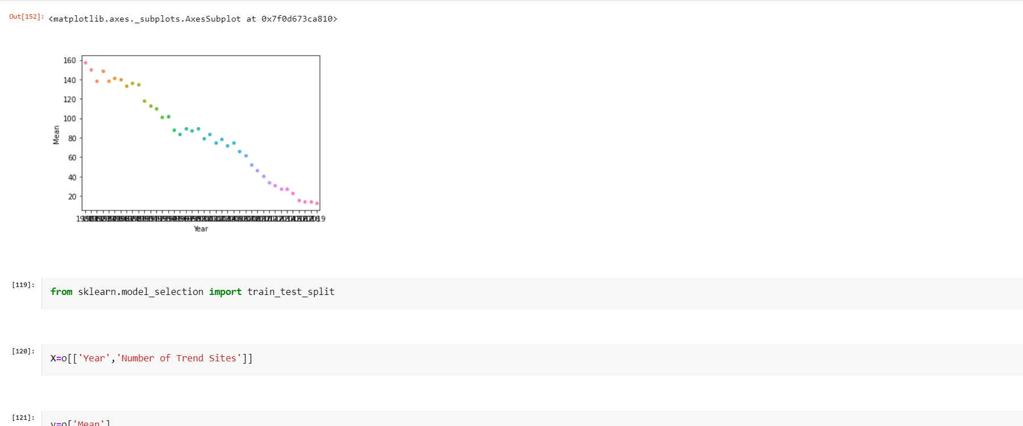

Slide 17
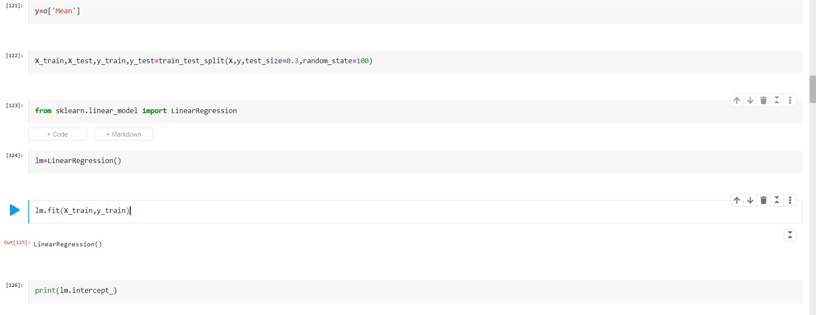
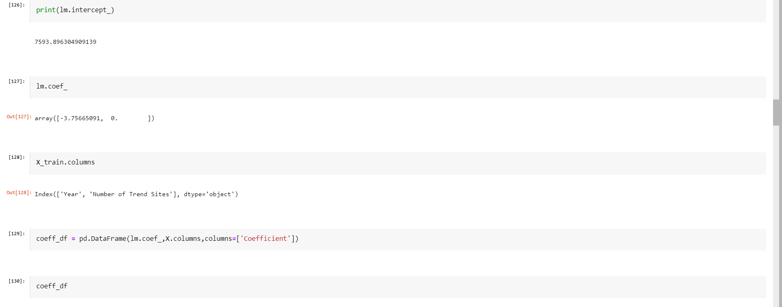

Slide 18
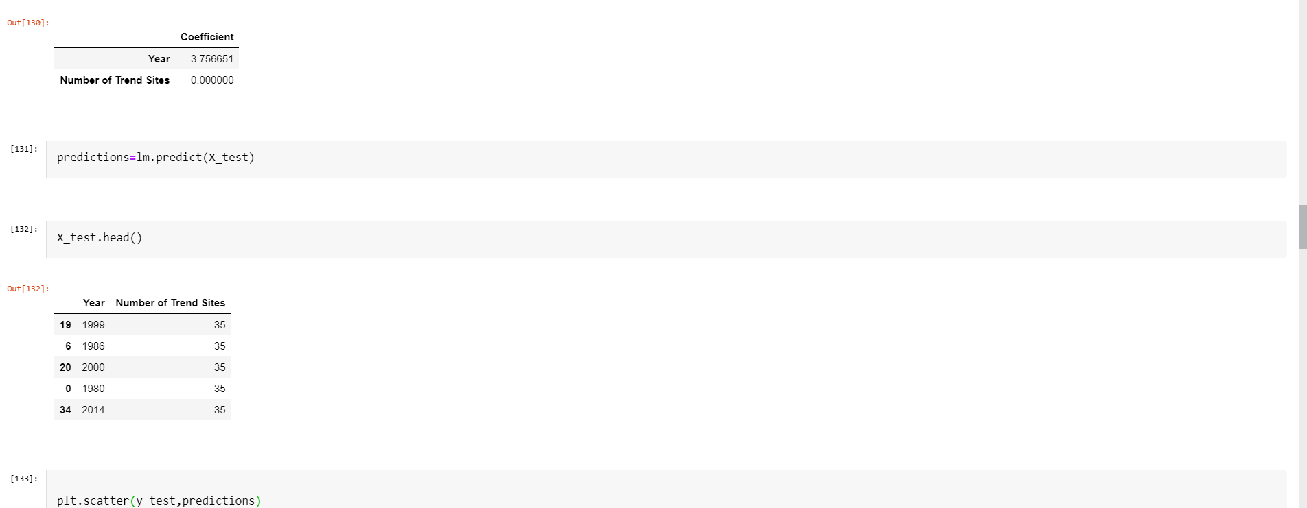
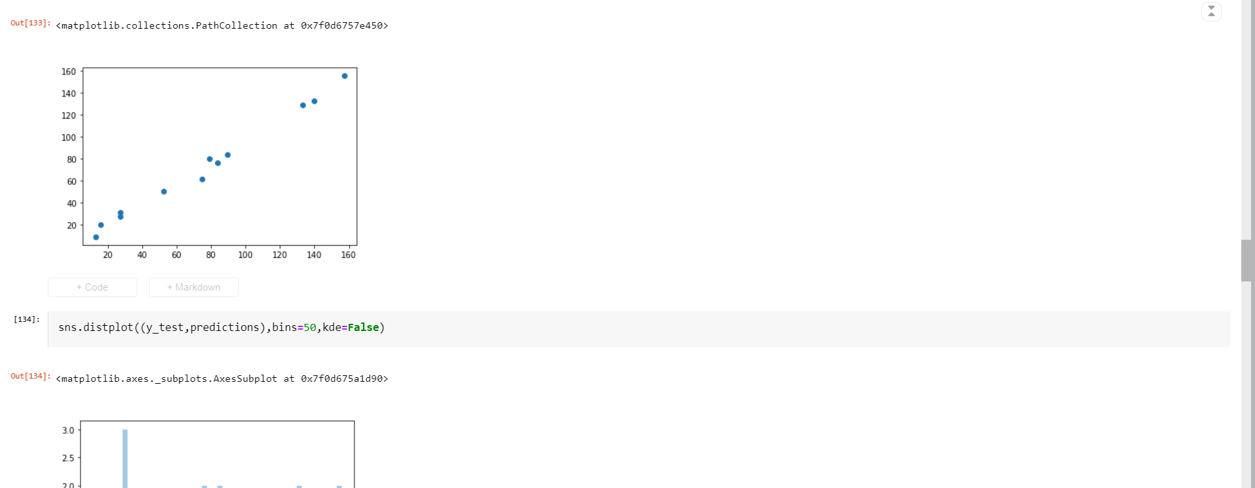

Slide 19
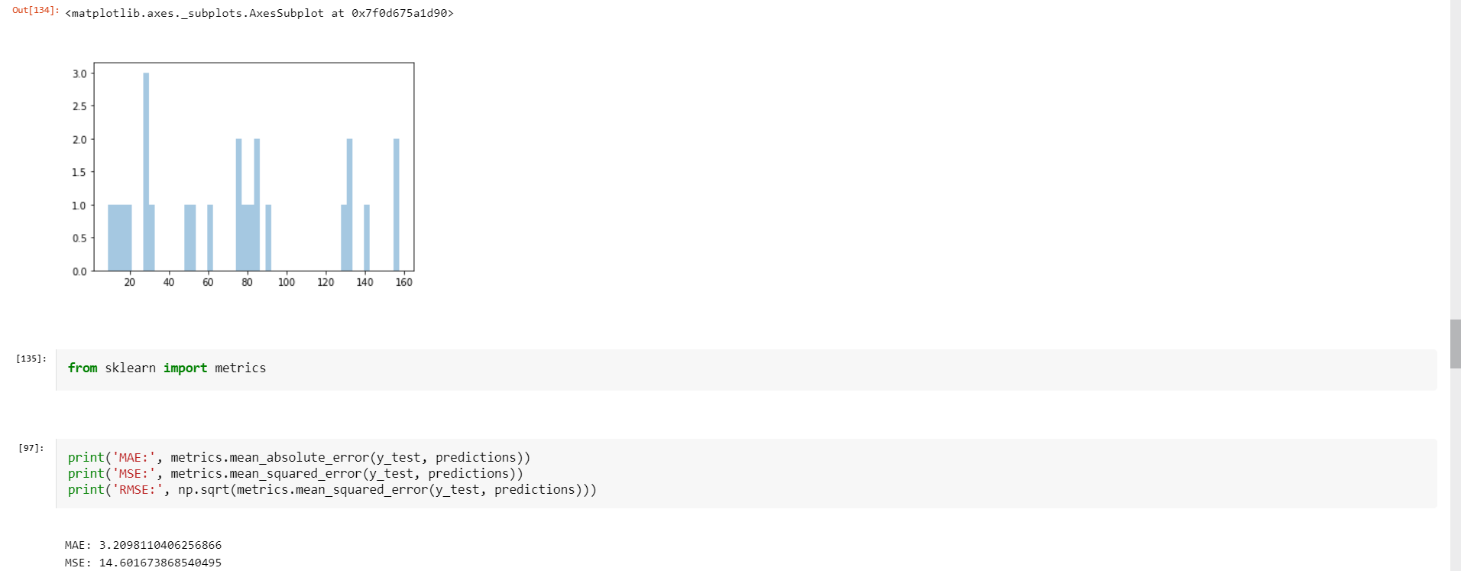
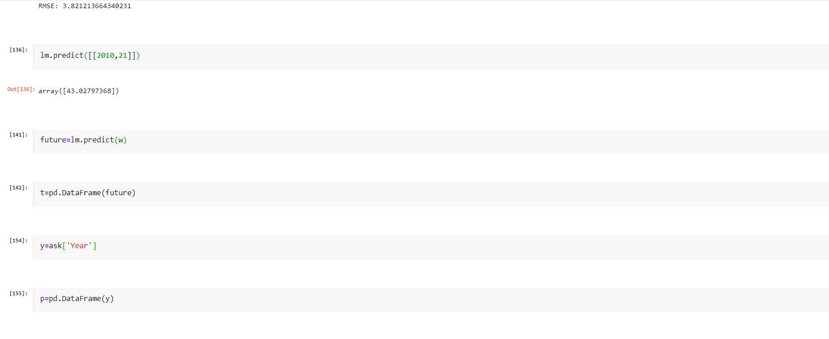

Slide 20
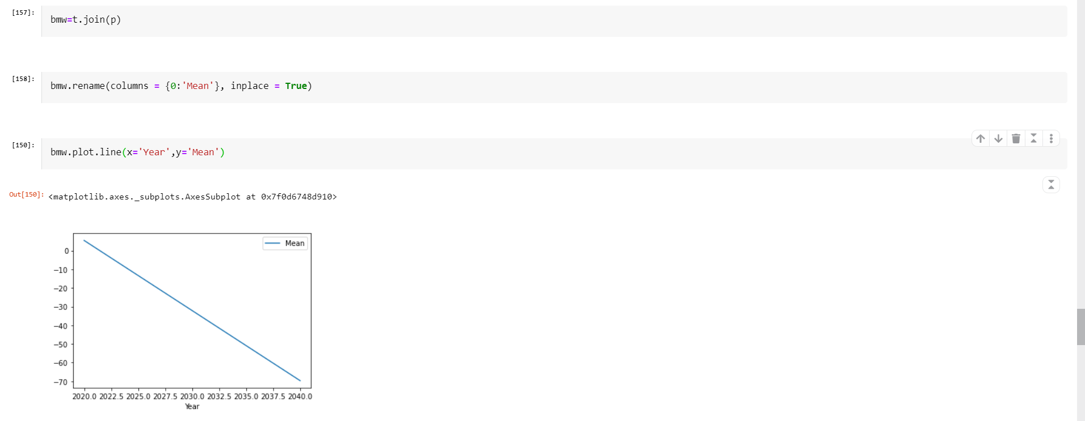
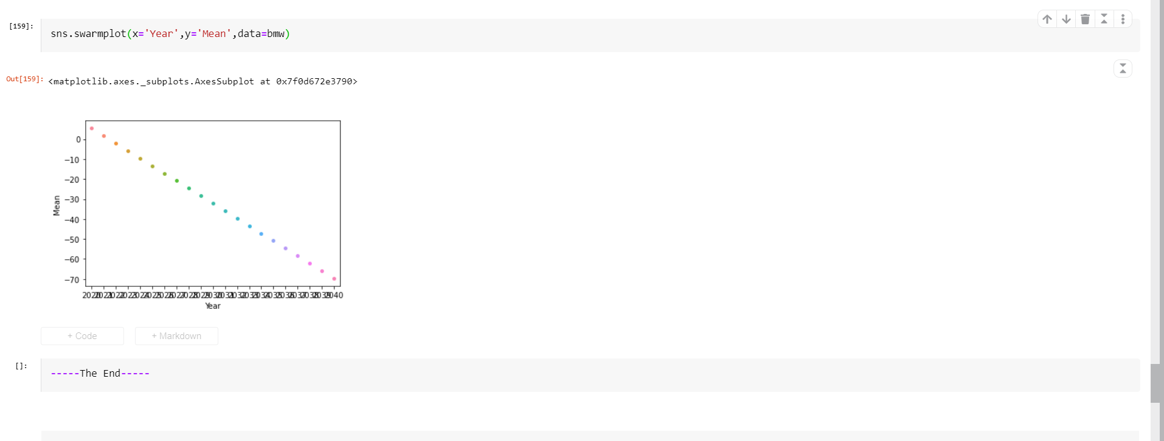
Thank you…

